Slide 1
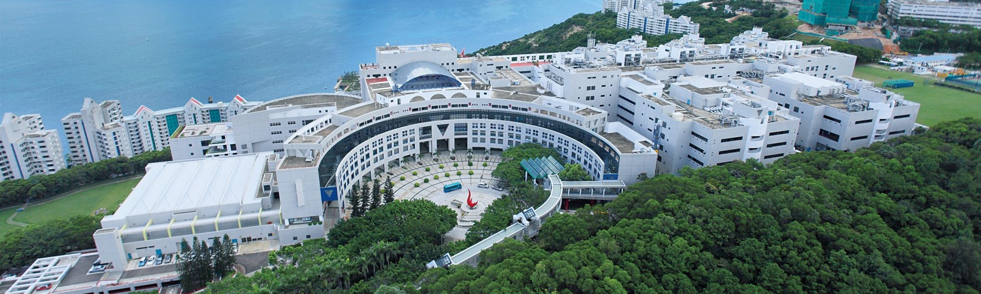
Accelerate Neural networks in resource-limited platforms
Peize LIU
Robotics Institute
Hong Kong University of Science and Technology

Slide 2
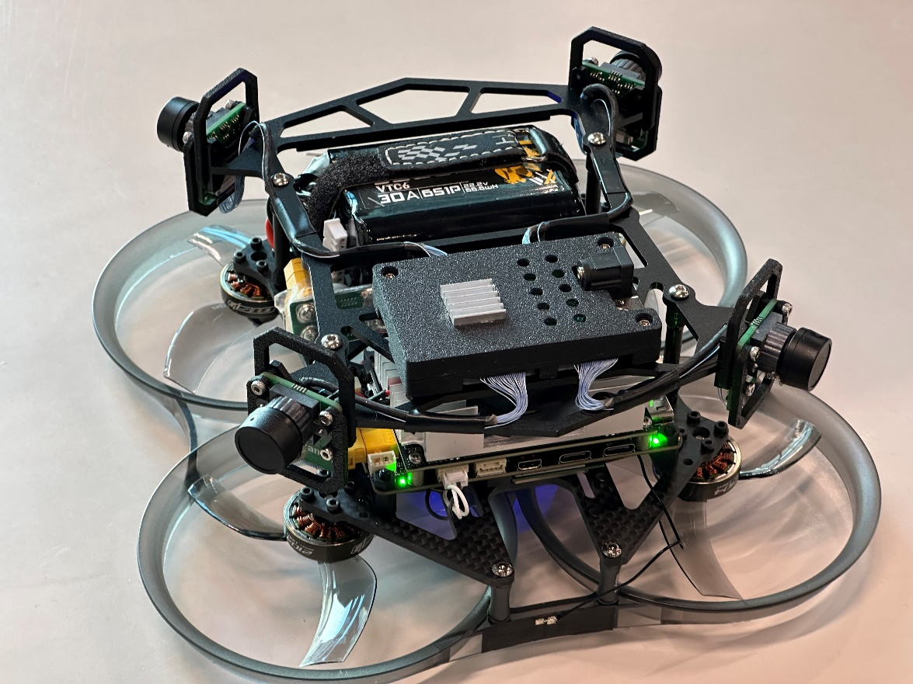
Outline
Our Swarm system progress
Acceleration skills in Neural networks implementation

Slide 3
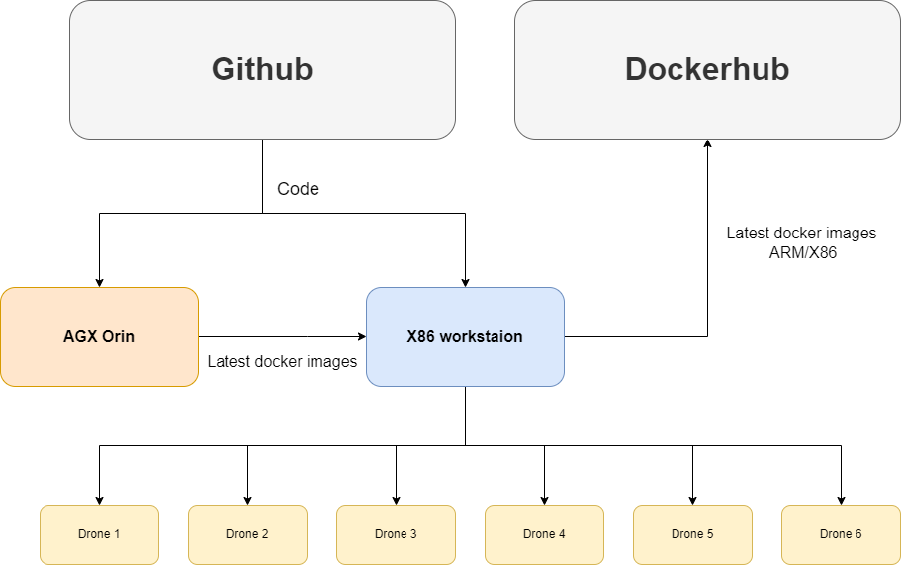
Progress in Swarm System
Fully automatic CI-CD system and firmware distribution network

Slide 4
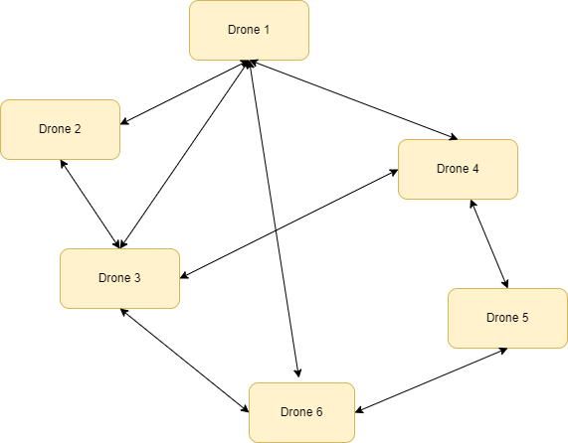
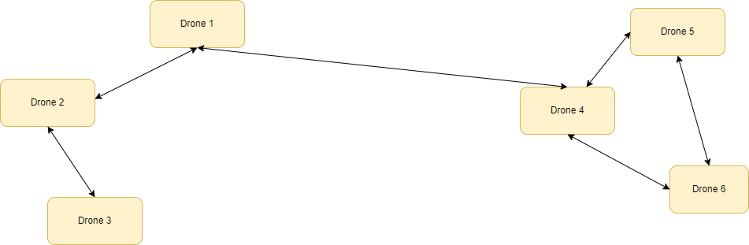
Progress in Swarm System
Fully automatic self-heal mesh network: Distributed and Decentralized ^{[1]}
Dense:
High-speed point-to-point transportation d2vins localization
Low latency
Only cover a small area (only in ideal experiments)
Spars
Low-speed data transportation
High latency
Large area
[1]: https://www.open-mesh.org/projects/batmand/wiki/VisualizeMesh

Slide 5
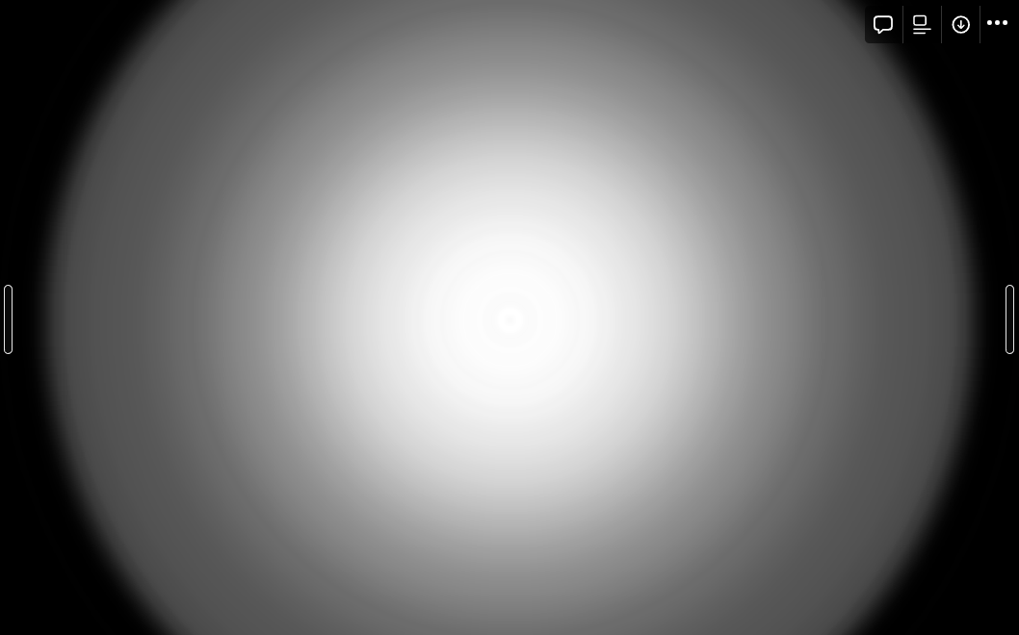
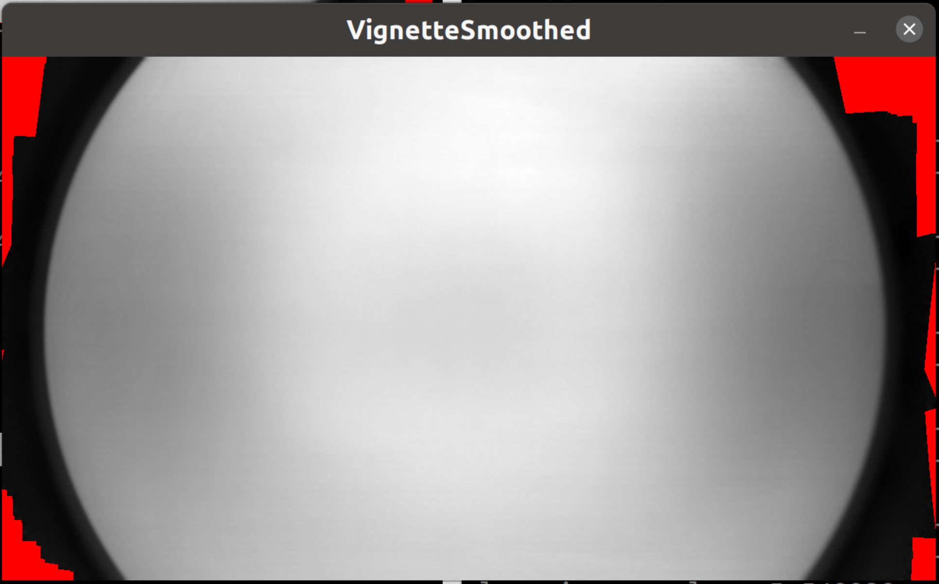
Progress in Swarm System
More refined photometric calibration for fisheye cameras^{[1]}
Original Version
DSO Version
Good with this version
[1]:Direct spase Odometry: Jakob Engel, Vladlen Koltun, Daniel Cremers https://cvg.cit.tum.de/_media/spezial/bib/bergmann17calibration.pdf
[2]:https://github.com/tum-vision/mono_dataset_code/tree/master
[3]:https://github.com/gaowenliang/vignetting_calib (William Gao version)

Slide 6

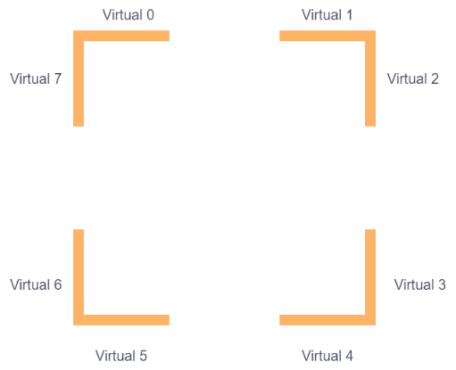
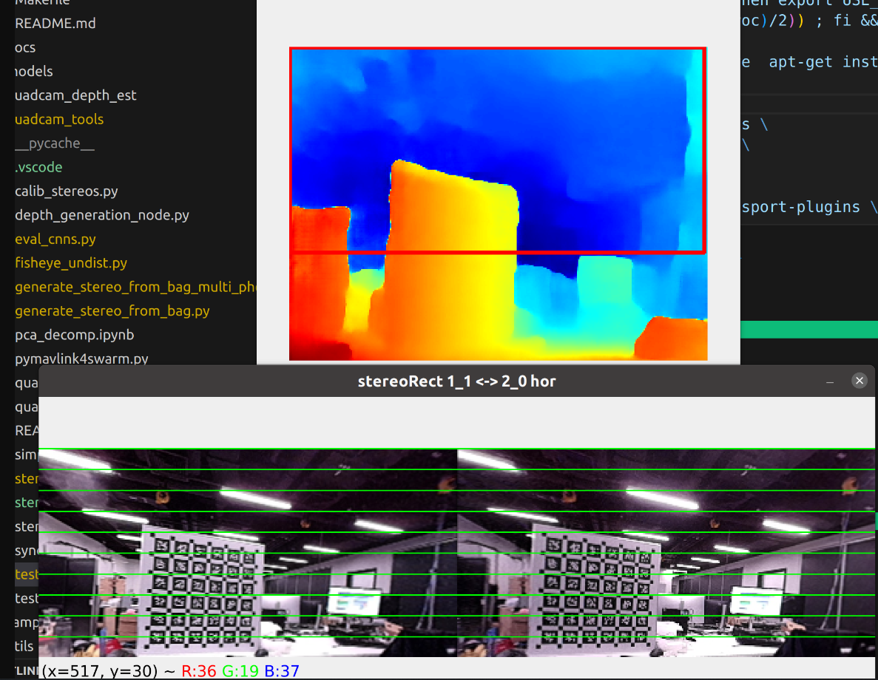
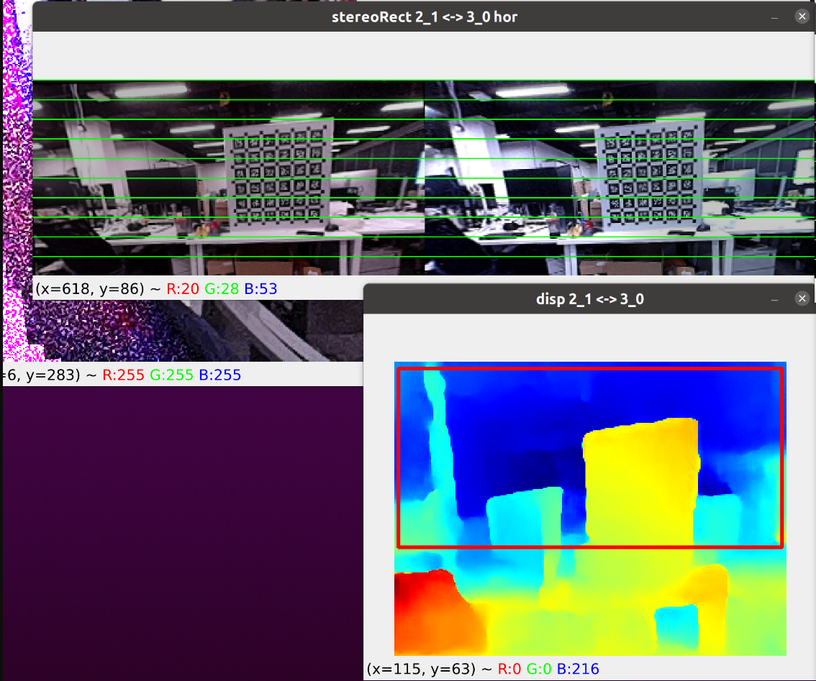
Omnidirectional Depth estimation
Four fisheye cameras with FOV up to 220 deg
Eight virtual pinhole cameras with FOV 95 deg
Photometric uncalibrated
Photometric calibrated

Slide 7
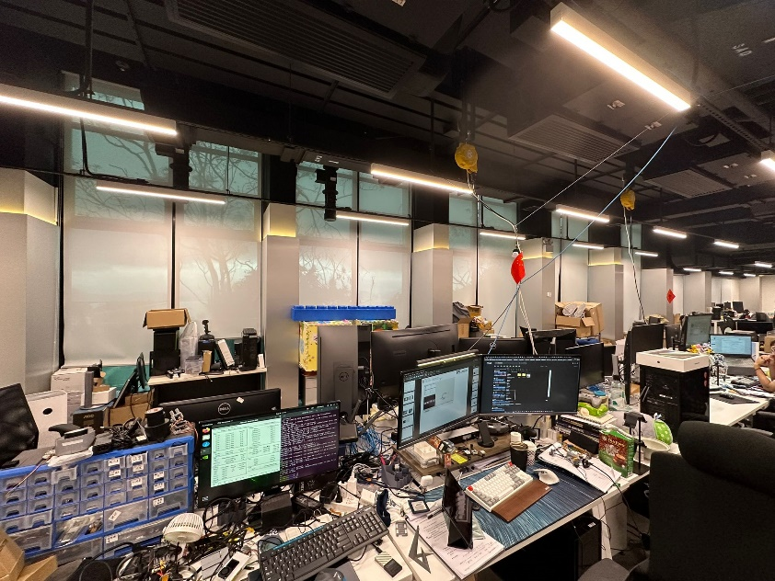
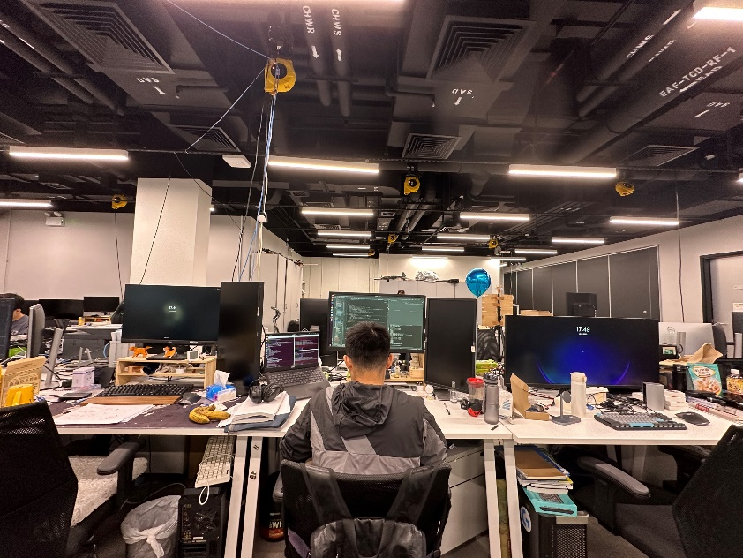
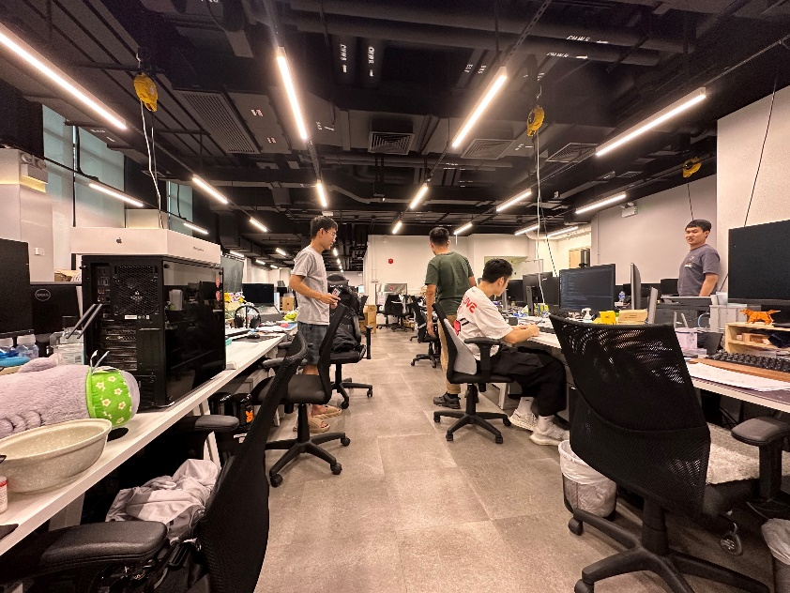
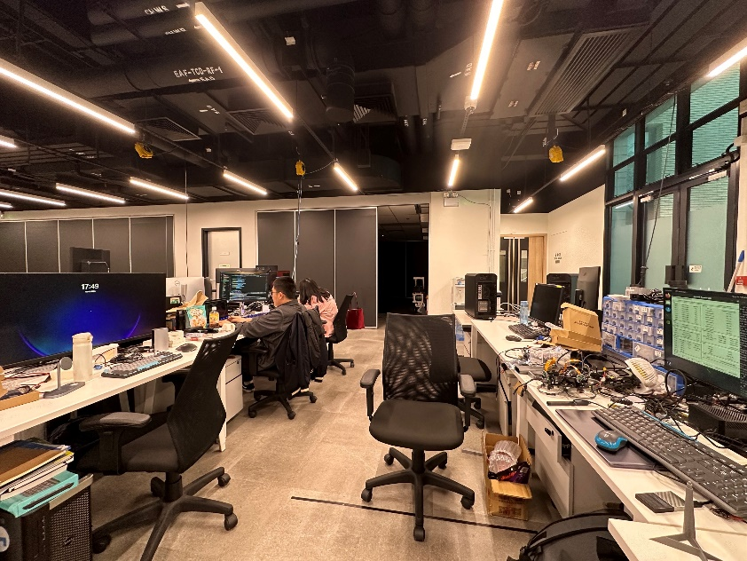
Scenario

Slide 8
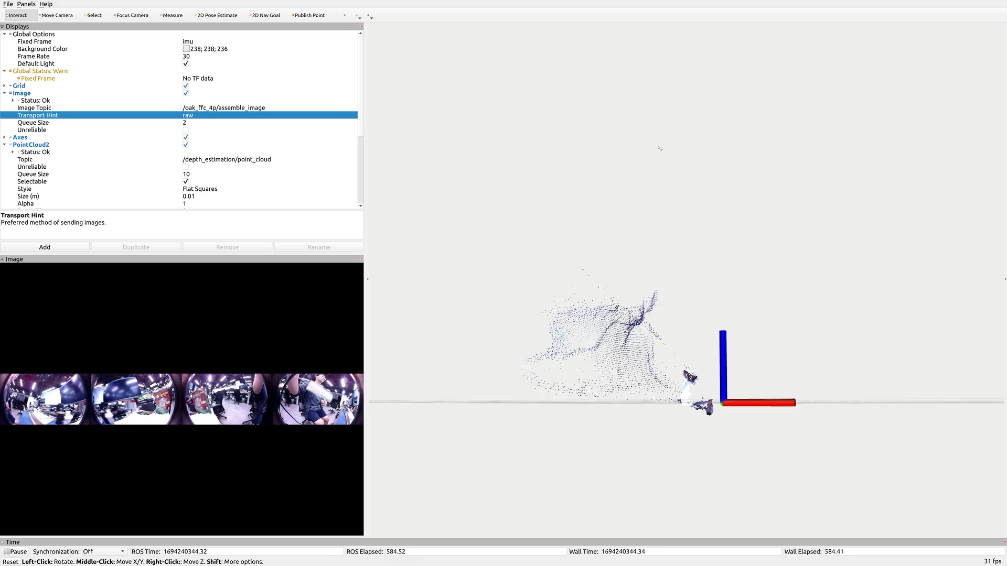
HITNET^{[1]} 240x320 fp16 optimized
[1]: HITNet: Hierarchical Iterative Tile Refinement Network for Real-time Stereo Matching, Vladimir Tankovich,Christian Häne ,.etc

Slide 9
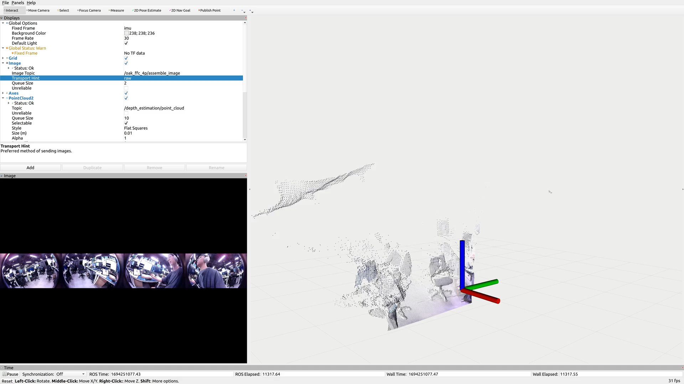
CREStereo^{[1]} 240x320 fp16 optimized
[1]: Practical Stereo Matching via Cascaded Recurrent Network with Adaptive Correlation: Jiakun Li Peisen Wang, etc.

Slide 10
Inference time comparison

Slide 11
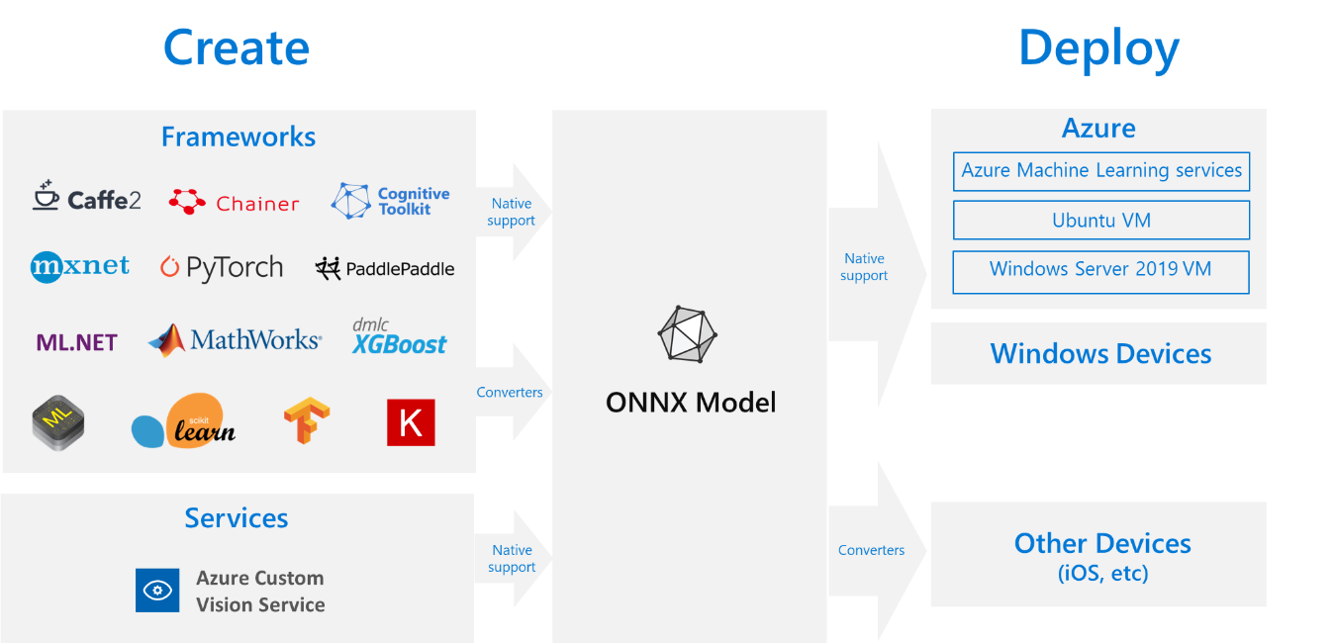
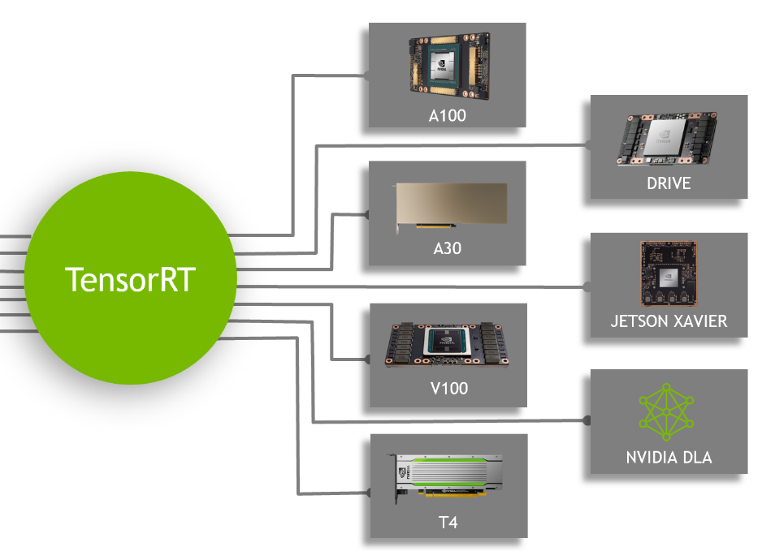
How to accelerate inference speed
Current workflow
Jetson Orin
Pytorch
ONNX
TensorRT

Slide 12
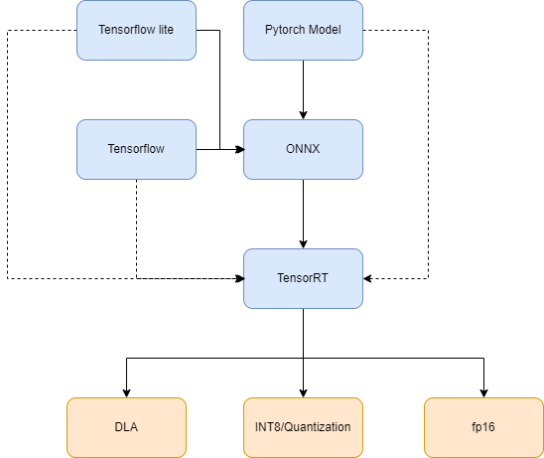
Workflow
Pytorch: layer design should consider TensorRT-supported operators
e.g.
einsum(x,x,x) not supported
einsum(x,x) supported!
Pytorch: layer design should consider using layers that can be accelerated via DLA cores^{[1]}
Quantization: Prepare enough calibration datasets(training data instead) to calibrate the model in INT8 inference accuracy/ fp16 acceleration can be performed by tensorrt tool
[1]: https://docs.nvidia.com/deeplearning/tensorrt/developer-guide/index.html#dla_layers

Slide 13
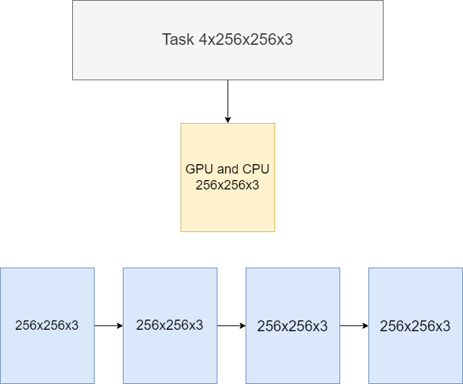
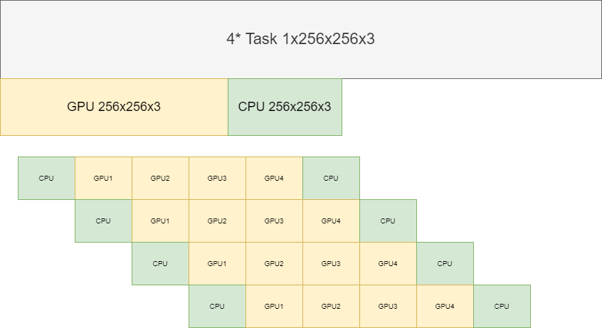
Should I do batch or multi-streams
Jetson Orin
Inference one block takes time t
Inference all takes 4*t
Inference one block takes time t,
inference four streams need 1.5t
Like FDM and TDM in the communication area

Slide 14
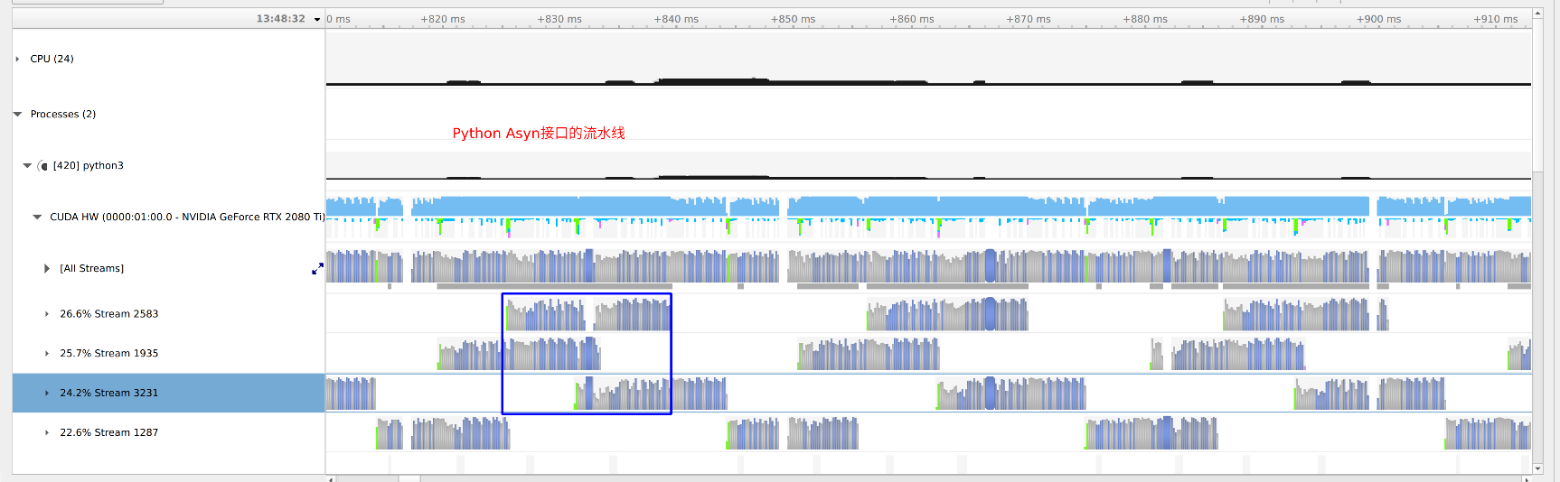
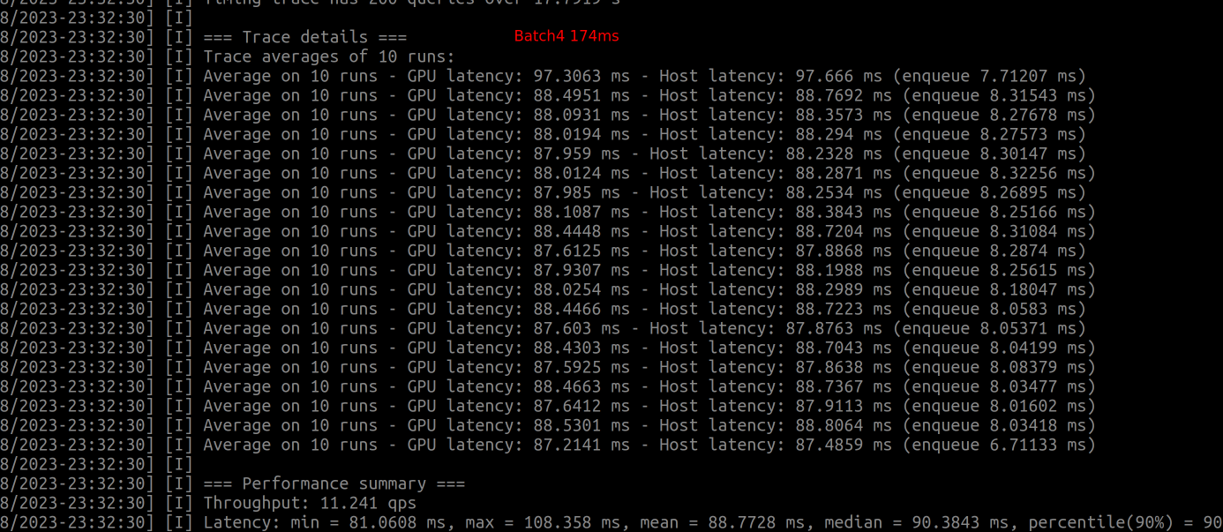
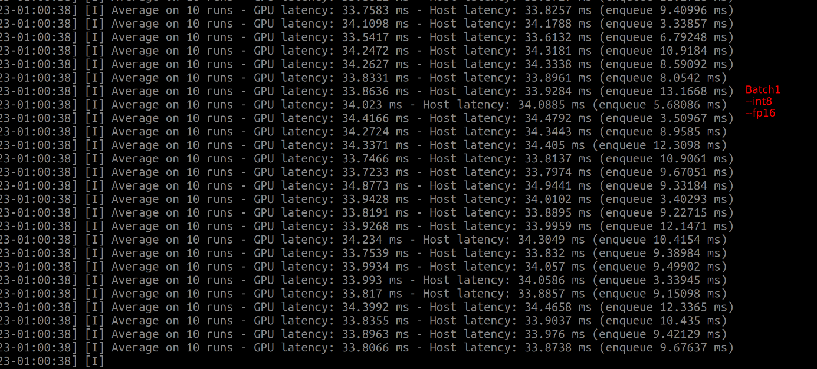

Slide 15
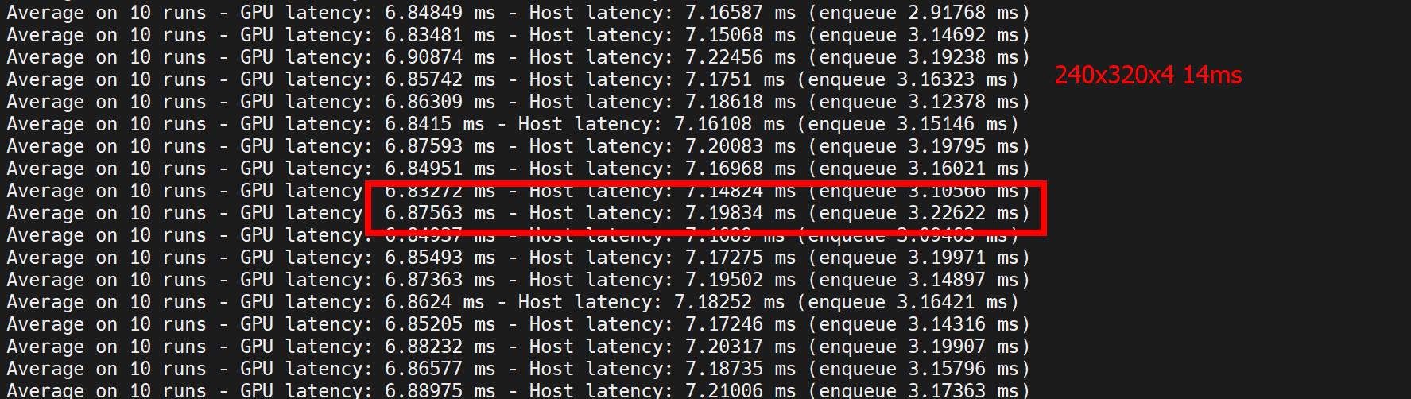
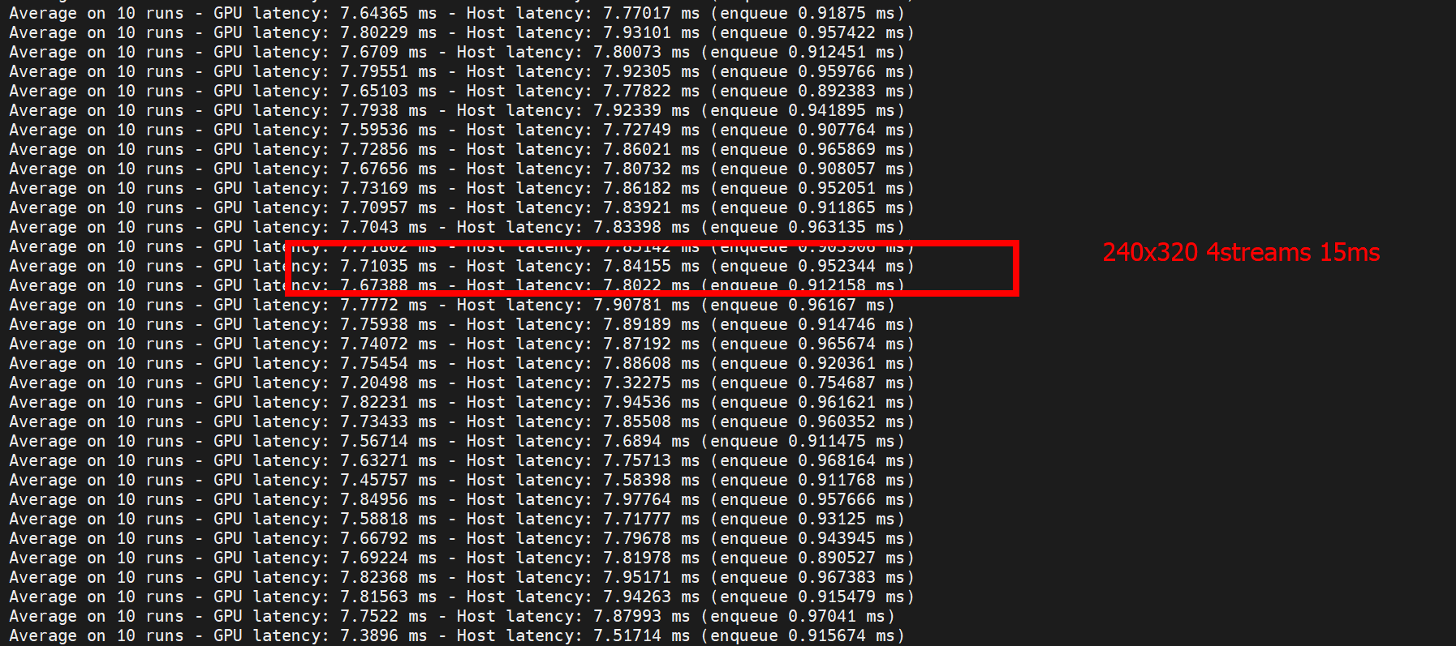
Is that still the same for 2080TI or 4090?

Slide 16
Thanks for your Listening

